Slide 1
Michael Allen Sprint #3 Review
Cleaning “Dirty Data” from Excel
And Making it “Tidy” in R

Slide 2
Game Plan
1. Export “Real” Excel SurveyMonkey “End of Course Survey” Data”(Dirty Data)
2. “Read” the Exported Excel Dirty Data into R
3. Write a Script in R to “Tidy” (Clean) the Dirty Data and “View” it in R
4. Export the R Tidy Data back to a CSV file

Slide 3
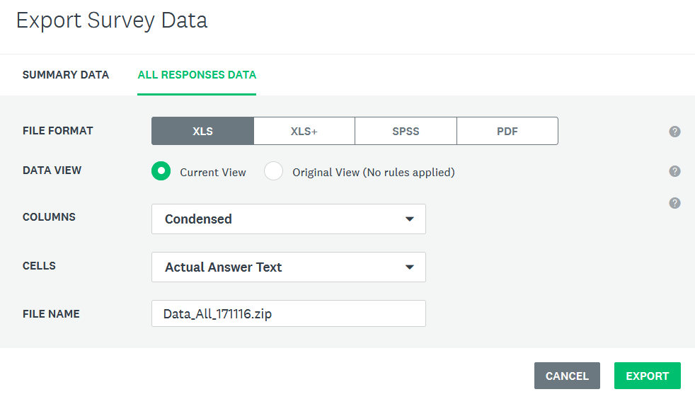
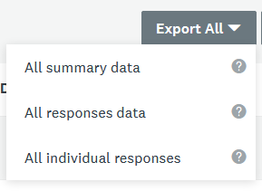
From SurveyMonkey Export End of Sprint Survey “Dirty Data” to Excel

Slide 4
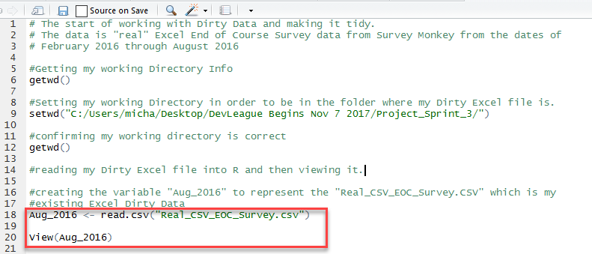

Viewing Existing Dirty Data in R
Unfortunately SurveyMonkey Creates Extra Column Names for Each Individual Instructor

Slide 5
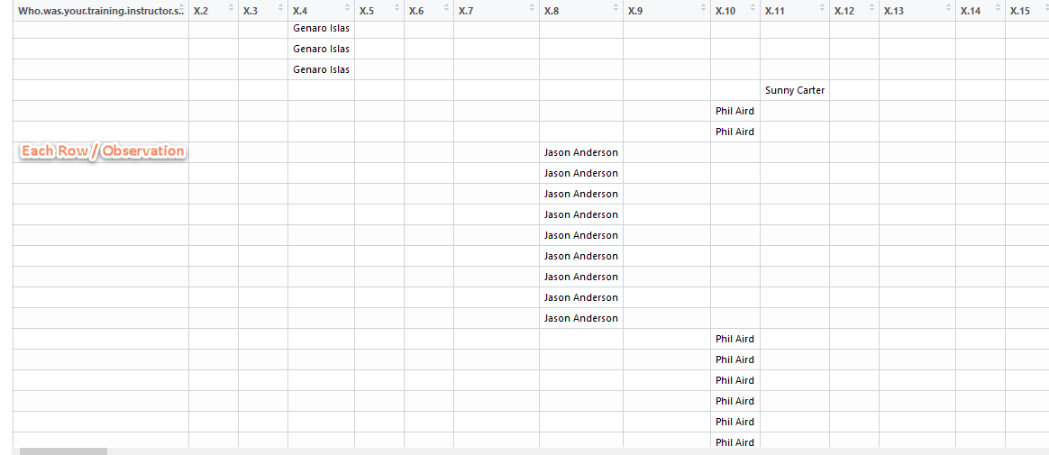
SurveyMonkey Creates Extra Column Names

Slide 6

How I Learned to Bring Them Into One Column
Rbind…? Paste…? Gather…? Copy…? Cbind…? Combine…? Collapse…?

Slide 7
Bringing Them Into One Column - Understanding Paste
df$x <- paste(df$n,df$s)
Name of the Data.frame (Table)
Name of the Old Column
Name of the Data.frame (Table)
Name of the new Column
Name of the Old Column
The Assign Operator
Name of the Data.frame (Table)
The Paste Function

Slide 8
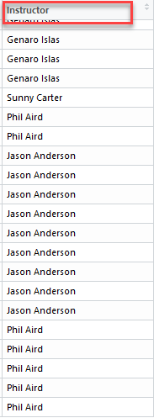
The Actual Paste Command and Result
Aug_2016$Instructor <- paste(Aug_2016$X.4,Aug_2016$X.6, Aug_2016$X.7,Aug_2016$X.8,Aug_2016$X.9,Aug_2016$X.10,Aug_2016$X.11,Aug_2016$X.13,Aug_2016$X.14,Aug_2016$X.15,Aug_2016$X.17,Aug_2016$X.18)

Slide 9
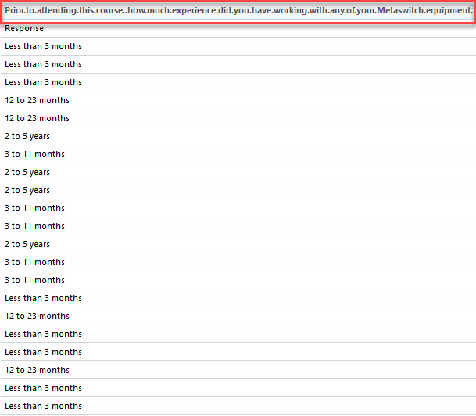
SurveyMonkey Creates Long Column Names

Slide 10

How I learned to Rename Long Column Names
Rename…?
Colnames…?
names…?
Prior to attending this course how much experience did you have working with any of your Metaswitch equipment
colnames(df)[colnames(df) == 'oldName'] <- 'newName’
(This is one way to do it…)

Slide 11
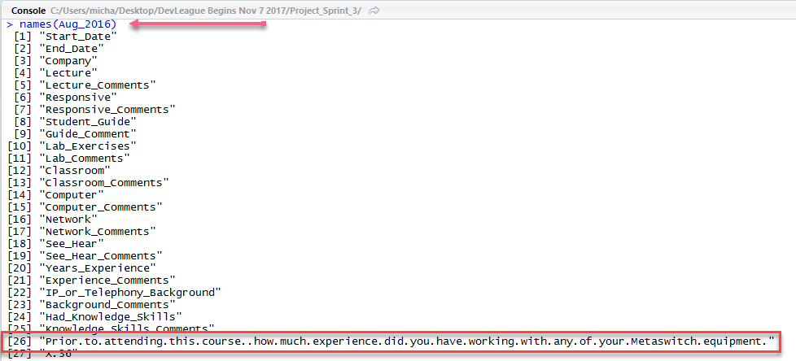
Learning to Rename Long Column Names
Names(Aug_2016)
Vector [26] Essentially means Column 26

Slide 12
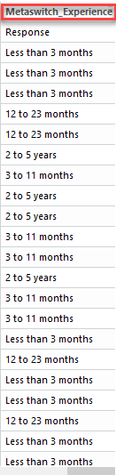
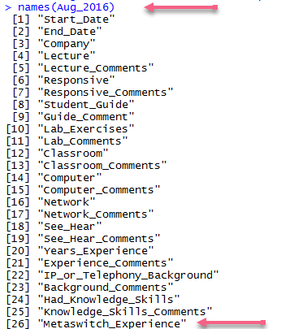
Learning to Rename Column Names by Vector
Names(Aug_2016)[26] <- “Metaswitch_Experience”
Vector [26]

Slide 13

Learning How to Delete Unwanted Column Names

Slide 14
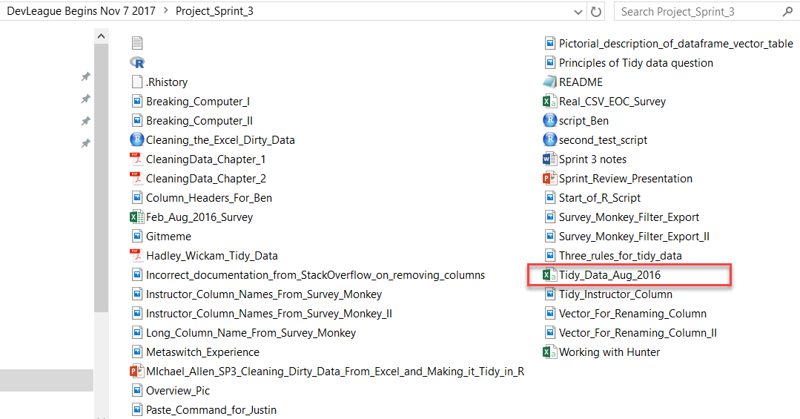

Learning to Export the R Tidy Data Back to a Clean CSV File
write.csv(Aug_2016, "Tidy_Data_Aug_2016.csv")

Slide 15
Create a Script in R to “Tidy” (Clean) the Dirty Data

Slide 16
Viewing the Tidy Data in R

Slide 17
Thank you

